Slide 1

korea
cryogenics
COMPANY PROFILE
안녕하세요
한국초저온용기 입니다
Hello, We are KC
Korea Cryogenics Co., Ltd. | Since 1990

Slide 2
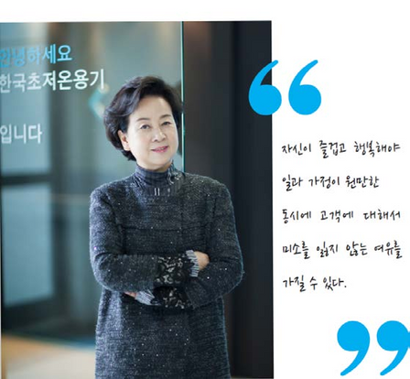



korea
cryogenics
company
at a
glance
02
Information
Name / Korea Cryogenics Co., Ltd. Founded/ 1990
CEO/ Heeran Lee
No. of Employees / 30 as of 2025
HQ Address / Seongnam-si, South Korea
Sales Revenue / $20M
Organization Chart
CEO
Managing Director
Cryogenics
CryoScience
Gas Engineering
Healthcare
Administration
Roturn Co., Ltd.
Overview
Specialized in marketing & sales of cryopreservation system, cryogenic dewar & refrigerator, cryogenic ancillaries, cryogenic bulk tank and vacuum jacket pipeline system. Leading supplier of cryogenic equipment and components to wide range of customers in various areas (ex. gas makers, hospitals, research centers, universities, and national organizations) Service Plant @Eum Sung, Chungbuk

Slide 3

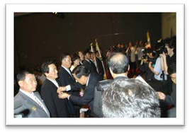

korea cryogenics
History
2009
Gas Facilities and Construction business of first class (No: Seongnam09-23-09)
1990
Korea Cryogenics Co., LTD founded
2010
A Medical Device Manufacturing License (KFDA3332)
1991
Service Factory Established
2011
GMP Certified (KTL-AA-110015)
1994
SoleAgent Contract with Taylor-Wharton, CRYOFAB, and TOMCO2
2013
Established Roturn Co., Ltd.
2001
Sole Agent Contract with LuxferGas Cylinders(Medical & Special Gas + Beverage CO2)
2014
GMP Certified(KTL-ABB-209001) KS Q ISO 9001:2009(QMS-14002)
2003
Taylor-Wharton Factory Registration KFDA approved AirSep’sOxygen Concentrator
2004
2018
Specific equipment manufacturing License
Sole Agent Contract with Sponsler
(now Turbines Incorp.)
2005
Received the Presidential Award for Gas Safety management
2020
High Pressure Gas License
2023
Construction Business Registration License [No: Seongnam-23-Pa-01]

Slide 4
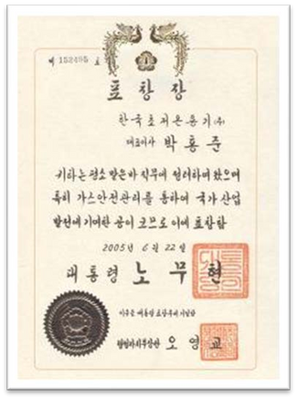
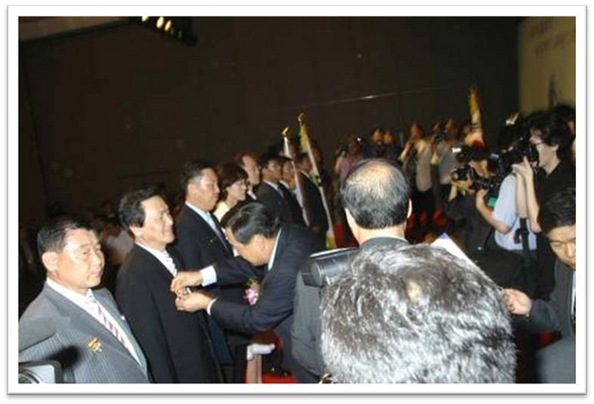
korea cryogenics
History
Acquired Presidential Award in 2005 for Gas Safety

Slide 5
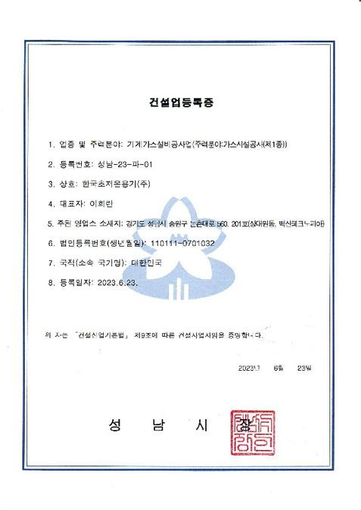
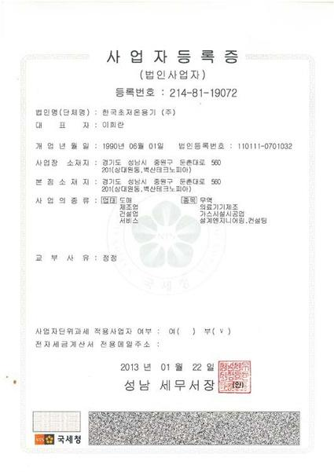
korea cryogenics
Company Profile
Business Registration Certificate
Construction Business Registration Certificate

Slide 6
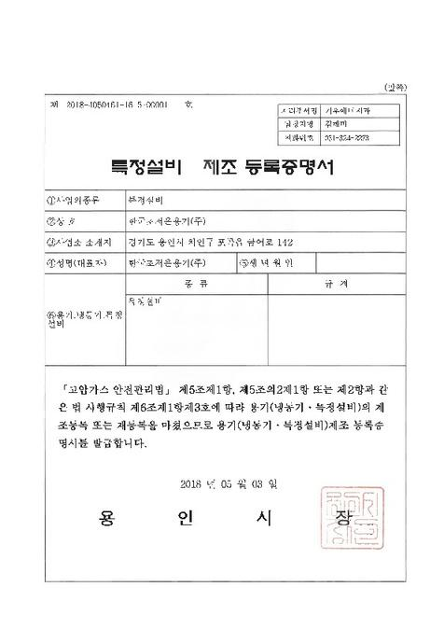
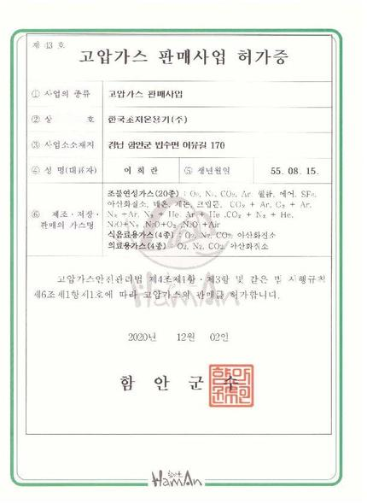
korea cryogenics
Company Profile
Specific Equipment Manufacturing Registration Certificate
High Pressure Gas Sales Business License

Slide 7
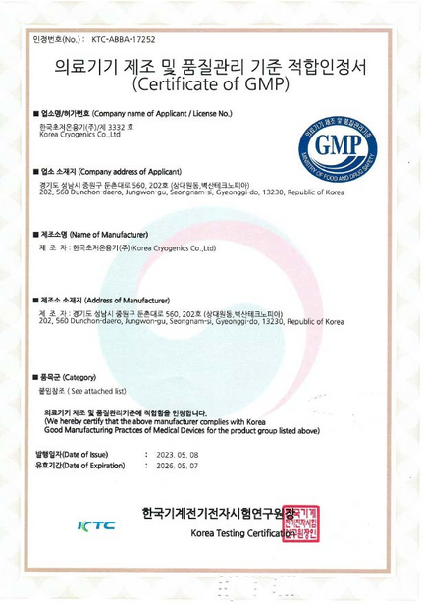
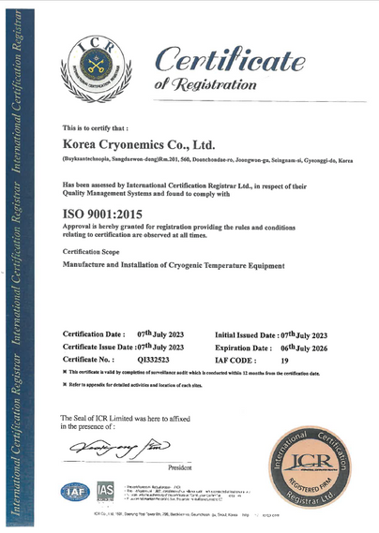
korea cryogenics
Company Profile
Certificate of GMP
KS Q ISO 9001:2009

Slide 8
korea cryogenics
Areas of Business
1.
Cryogenics
Liquid Gas Low pressure Cylinders(22psi)
3.
Gas Engineering
CO2 water treatment system
Liquid Gas Medium pressure Cylinders(230psi) Liquid Gas High pressure Cylinders(350psi) Bulk Storage Vessels MicroBulk Solutions Liquefied Hydrogen Tank & Tank Lorry
Cryogenic liquefied gas flowmeter
Vacuum jacketed pipeline system
Engineering gas processing facilities
2.
CryoScience
Cryostorage System Cryogenic Refrigerator & Dewar
4.
Healthcare
Portable aluminum Oxygen cylinders for medical & homecare
Aluminum Cylinders for special gas
Cryogenic Bulk Storage Tank Cryo Vial Liquid Helium Containers Liquid Helium Hose & Accessories O2 monitoring System

Slide 9
korea cryogenics
Areas of Business
Cryogenics
1.

Slide 10
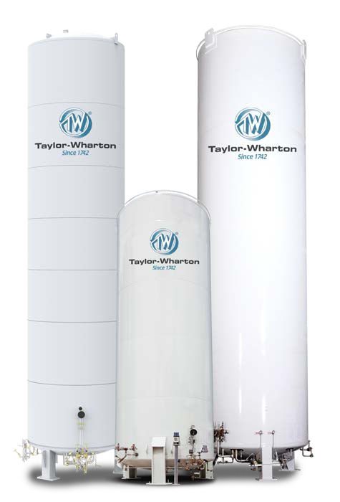
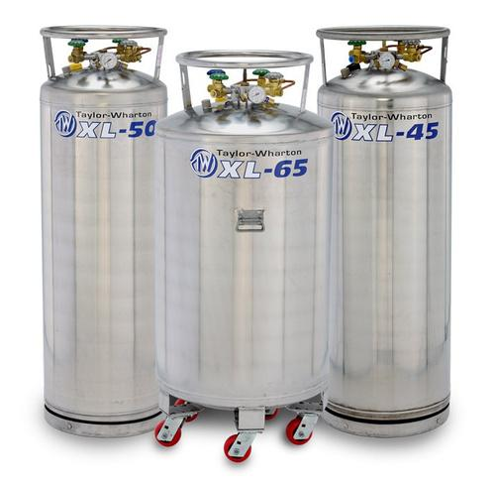
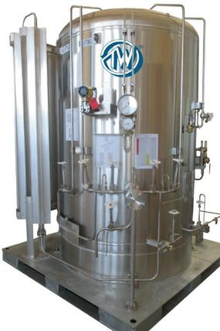
korea cryogenics
1. Cryogenics
Manufactured by TWM in Malaysia DOT approved Vacuum-insulated Ideal for handling a wide variety of gases or liquefied gases(Oxygen, Nitrogen and Argon) Over 50,000 cylinders sold in Korea Sole TW distributor in Korea for 25 years
Liquid Gas Low pressure Cylinders(22psi) Liquid Gas Medium pressure Cylinders(230psi) Liquid Gas High pressure Cylinders(350psi)
Key customers: 70 gas distributors nationwide Air Products Korea Praxair Korea Air Liquide Korea Linde Korea Daesung Sanso

Slide 11
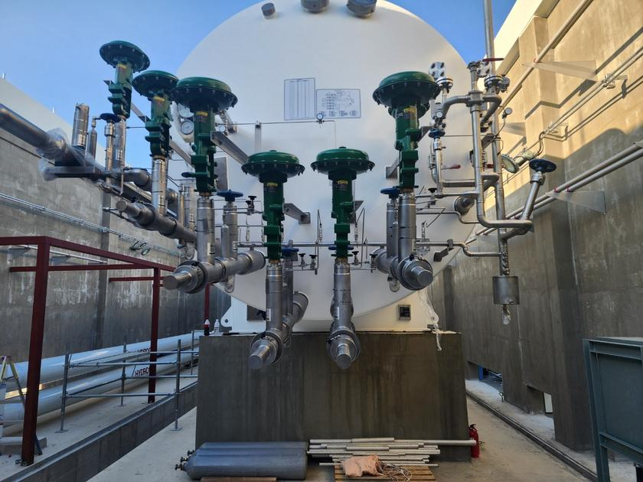
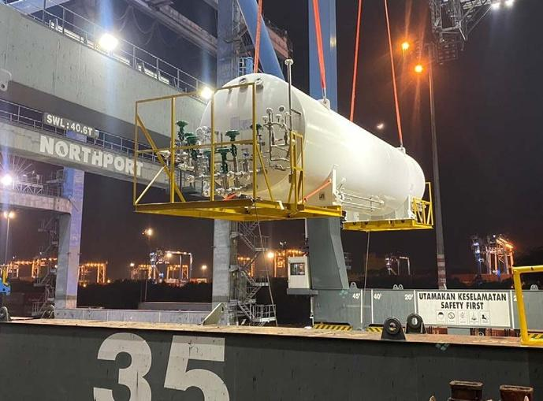
korea cryogenics
1. Cryogenics
Manufactured by TWM in Malaysia ASME approved Vacuum-insulated Introduced of the 1st Liquefied hydrogen tank in Korea
Liquefied HydrogenTank Liquefied Hydrogen Tank Lorry
Key customers: SK E&S/ Nikkiso SK Materials Airplus Hyosung/ Linde LHF Korea Gas Safety Corp.

Slide 12
korea cryogenics
Areas of Business
CryoScience
2.

Slide 13
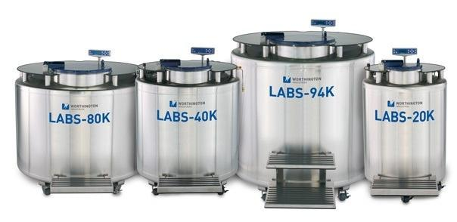
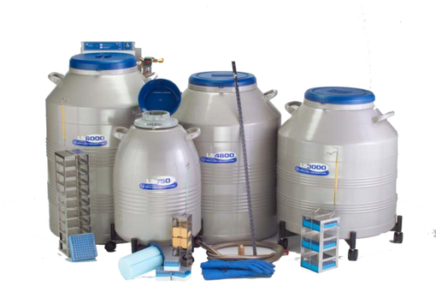
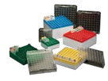
korea cryogenics
2. CryoScience
Manufactured by IC Biomedical in USA LN2 storage in either liquid or vapor phase
All stainless-steel construction
Single-point aluminum turntable design
Hinged lid and stainless steel table top working surface
Enhanced and intuitive controller technology
Data collection, event scheduling and enhanced security
Over 500 LABS sold in Korea
Cryostorage System Cryogenic Refrigerator & Dewar Cryogenic Bulk Storage Tank CryoVial & Boxes O2 Monitoring System

Slide 14
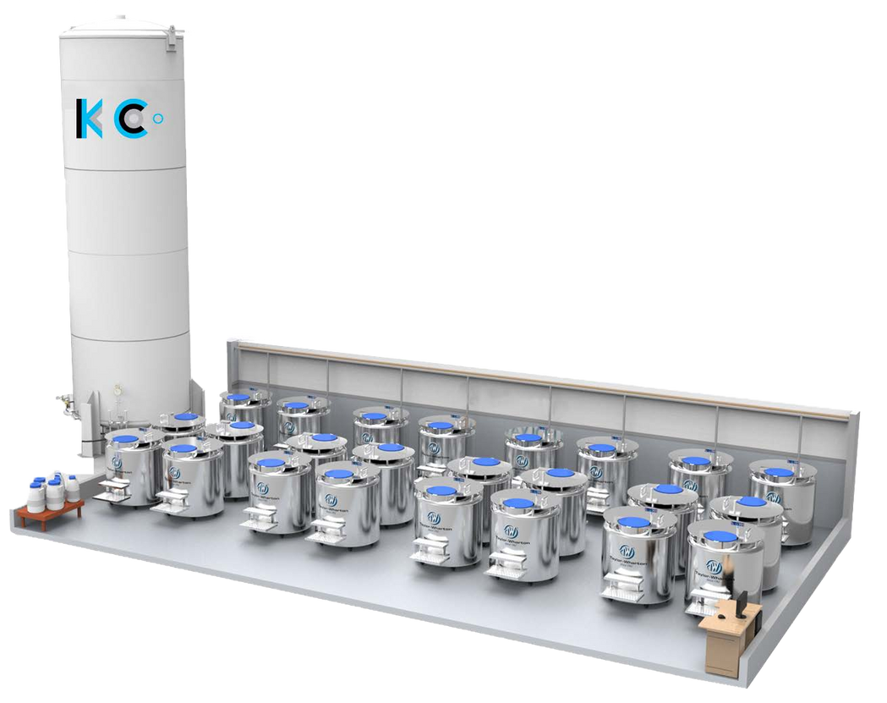
korea cryogenics
2. CryoScience
Working with the Gas Engineering team at KC, we provide the best total cryobiobanking system for customers no matter what conditions and limitations they have
Total CryoPreservation Solution -
LN2 Bulk Tank
LABS and Small RDFs
VIP
Network monitoring System

Slide 15

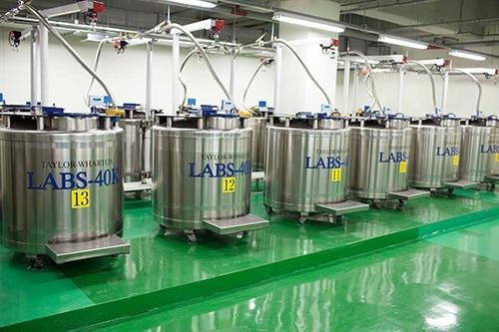
2. CryoScience
At National Cancer Center

Slide 16
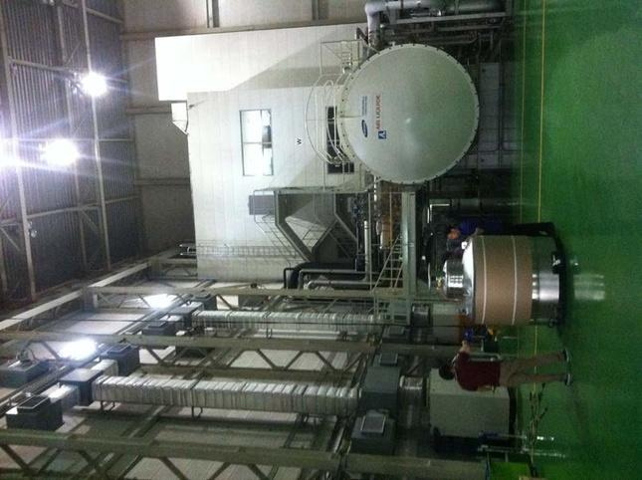
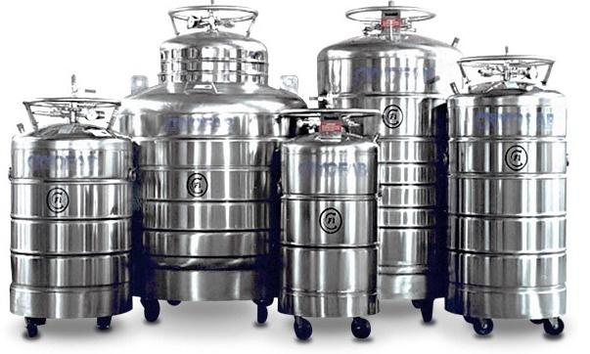
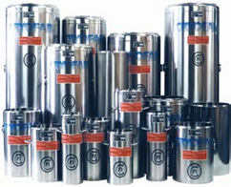
korea cryogenics
2. CryoScience
Manufactured by Cryofabin New Jersey No liquid nitrogen shielding, or helium gas circulation required Lightweight but rugged construction stands up to trucking and everyday abuse Suitable for air transport All welded construction Lowest loss rates in the industry All units equipped with integral caster base Easily removable and interchangeable manifolds Applications include Distribution, Research and Liquefaction Over 2,000 units sold in Korea
Liquid Helium Containers Liquid Helium Hose & Accessories

Slide 17
korea cryogenics
Areas of Business
Healthcare
3.
17

Slide 18
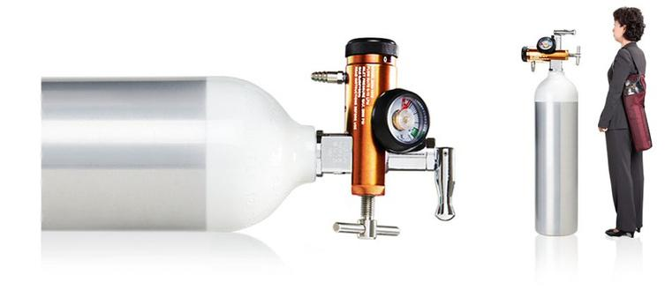
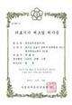
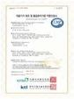
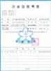
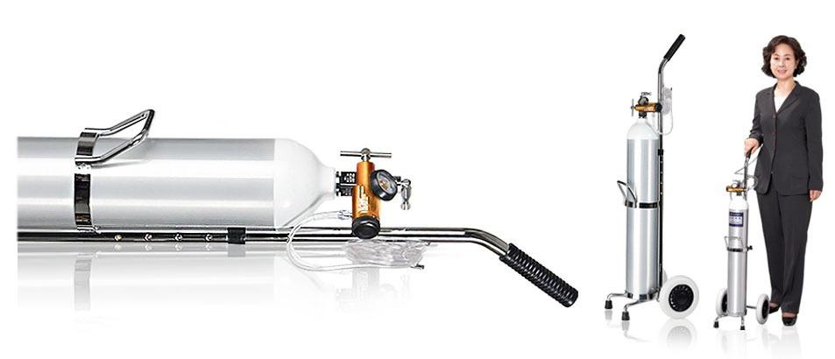
korea cryogenics
4. Healthcare
Oxygen Gas Cylinders for all major general hospitals, Over 100,000 cylinders sold
Certificate of GMP
Medical equipment manufacturing license
Portable aluminum Oxygen Cylinders and accessories for medical & homecare
Aluminum cylinders for special gas

Slide 19
korea cryogenics
Areas of Business
Gas Engineering
4.
19

Slide 20
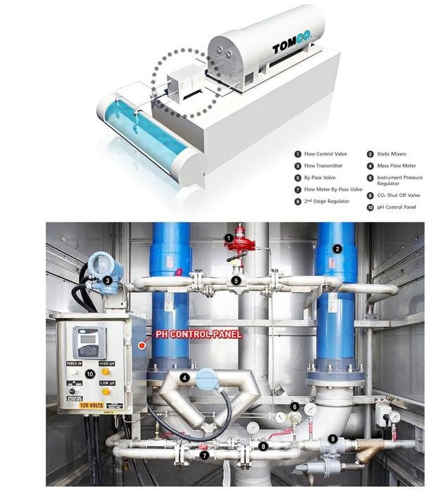
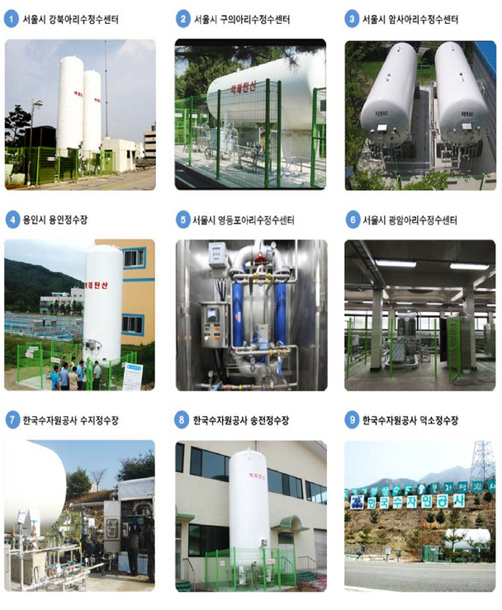
korea cryogenics
4. Gas Engineering
CO2 water treatment system

Slide 21
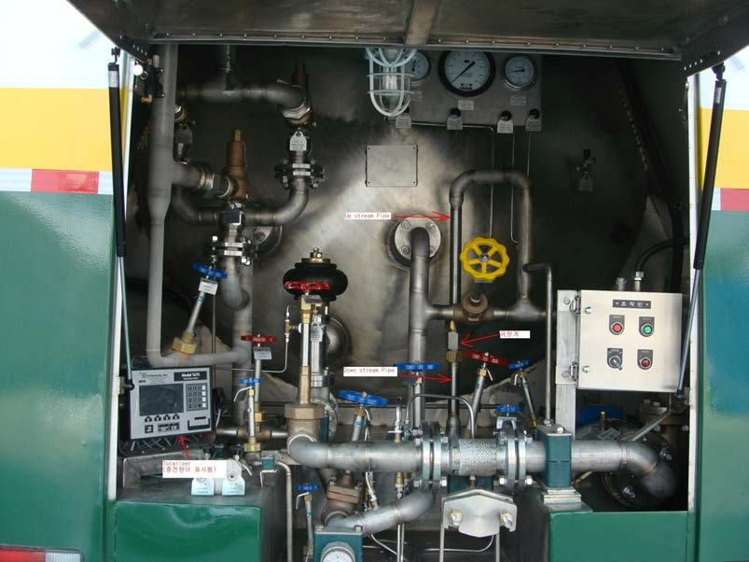
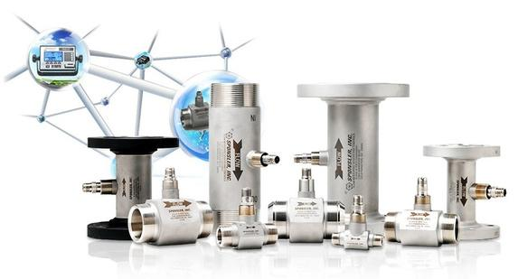
korea cryogenics
3. Gas Engineering
Cryogenic Liquefied Gas Flowmeter

Slide 22
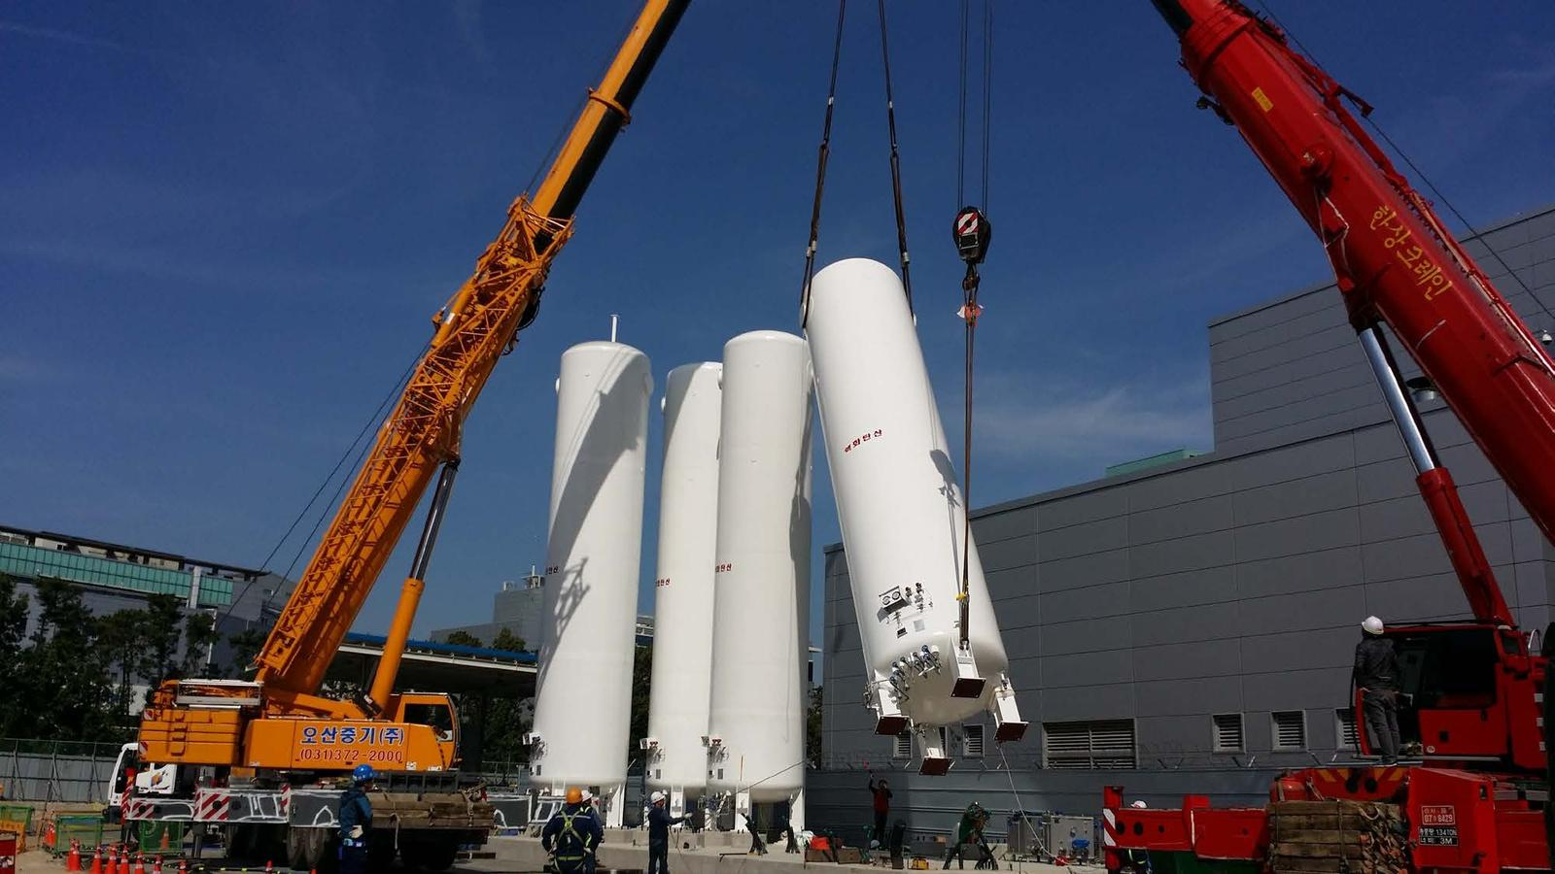
korea cryogenics
4. Gas Engineering
Engineering gas processing facilities
At Samsung Semiconductor plant

Slide 23
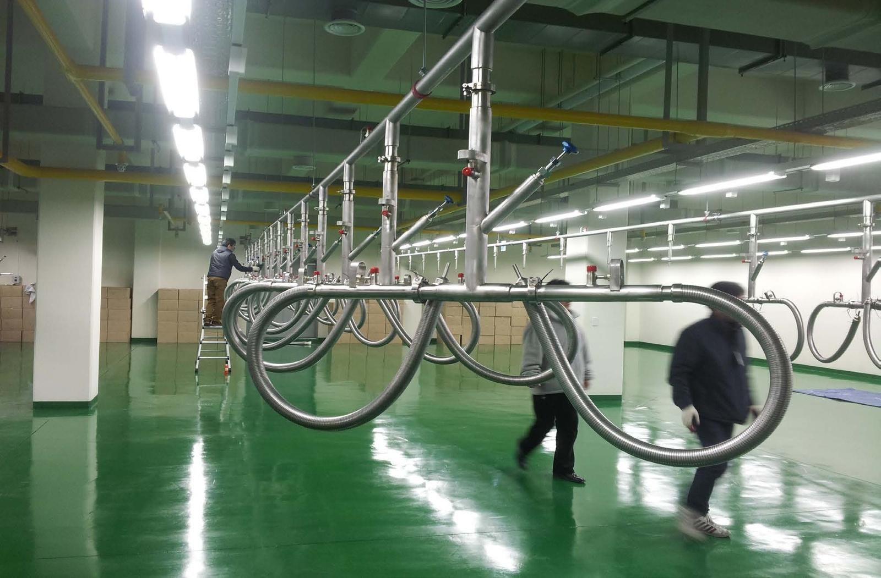
korea cryogenics
4. Gas Engineering
Vacuum Jacketed pipeline system
At kora Disease Control and Prevention Agency

Slide 24
korea cryogenics
Key Supply Performance
Pohang Accelerator Laboratory
PLS-II LIN Supply System
Samsung Electronics
AMLCD Module Fab & CO2Supply System
Pohang Accelerator Laboratory
He & LIN Vacuum Jacket Piping
Seoul Nat’lUniversity BoramaeMedical Center
LIN Supply System
DAEWOO ENGINEERING & CONSTRUCTION CO.,LTD
CO2Supply System for Guri Arisu Purification Center
Asan Medical Center
LIN Supply System
National Cancer Center
LIN Supply System
POSCO
LIN Supply System
Korea Disease Control and Prevention Agency
LIN Supply System
Samsung Display
Cheonan 6L CO2Supply System
Samsung Display
A3L-He Vacuum Jacket Piping.
Samsung Electronics
17Line S3-Project CO2 Supply System
24

Slide 25
korea cryogenics
Key Supply Performance
Samsung Electronics
K2 LIN Supply System.
Korea Photonics Technology Institute
LIN Supply System.
SKHynix
M10A Oxygen yard Vaporizer expansion
Samsung Electronics
P1 Project CO2Supply System
Dongsan Medical Center
LOX & LIN Supply System
Samsung Electronics
P2 Project CO2Supply System
Samsung Electronics
E-Project CO2Supply System
Samsung Electronics
P2_UT2 Building CO2 Supply System
Samsung Electronics
V1 CO2_L.P Module
Samsung Electronics
P3 Project CO2Supply System
Samsung Electronics
T-Project BSGS CO2Supply System(U.S.A)
NRD-K Project
Samsung Electronics
25

Slide 26
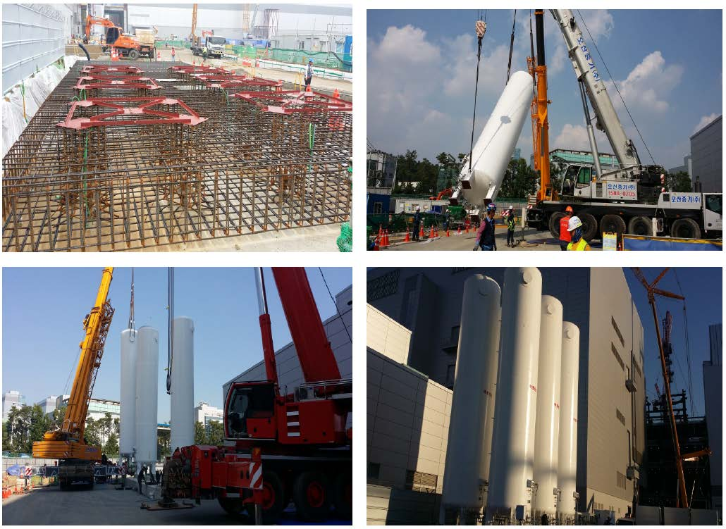
korea cryogenics

Slide 27
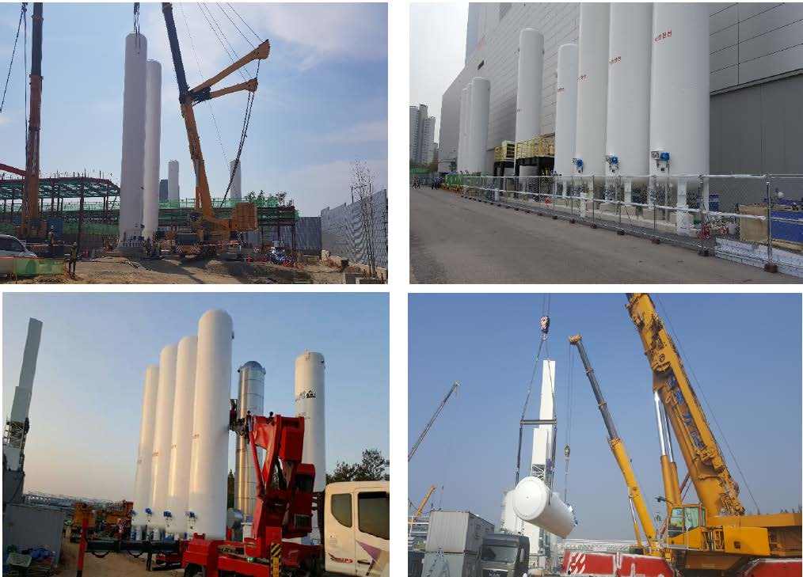
korea cryogenics

Slide 28
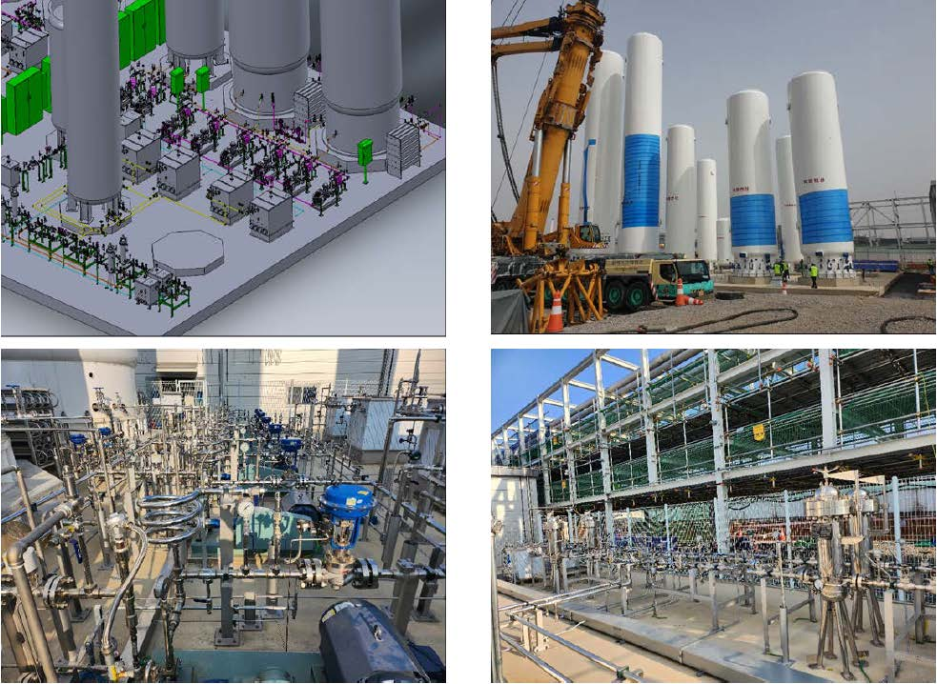
korea cryogenics

Slide 29
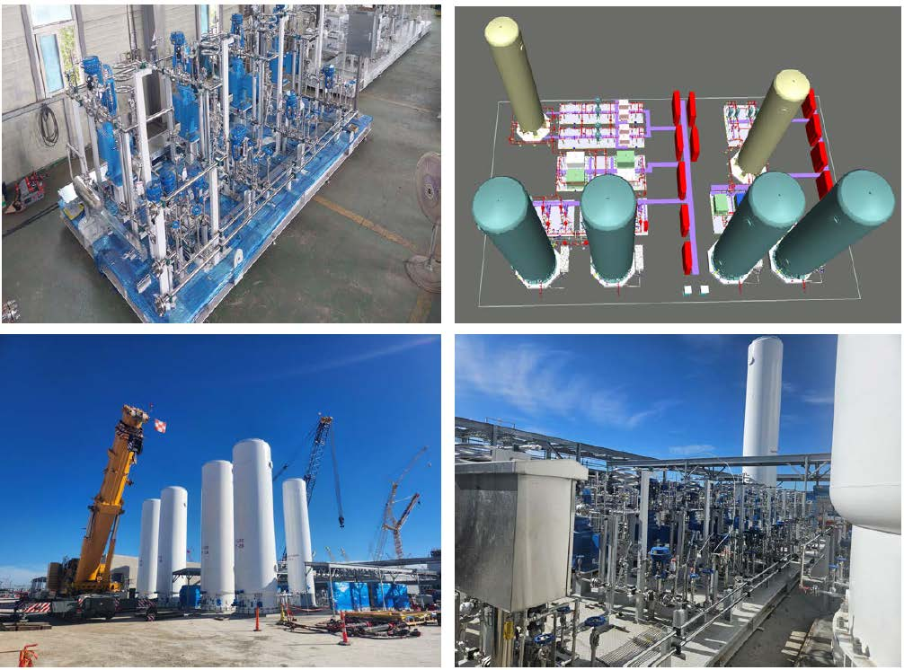
korea cryogenics

Slide 30
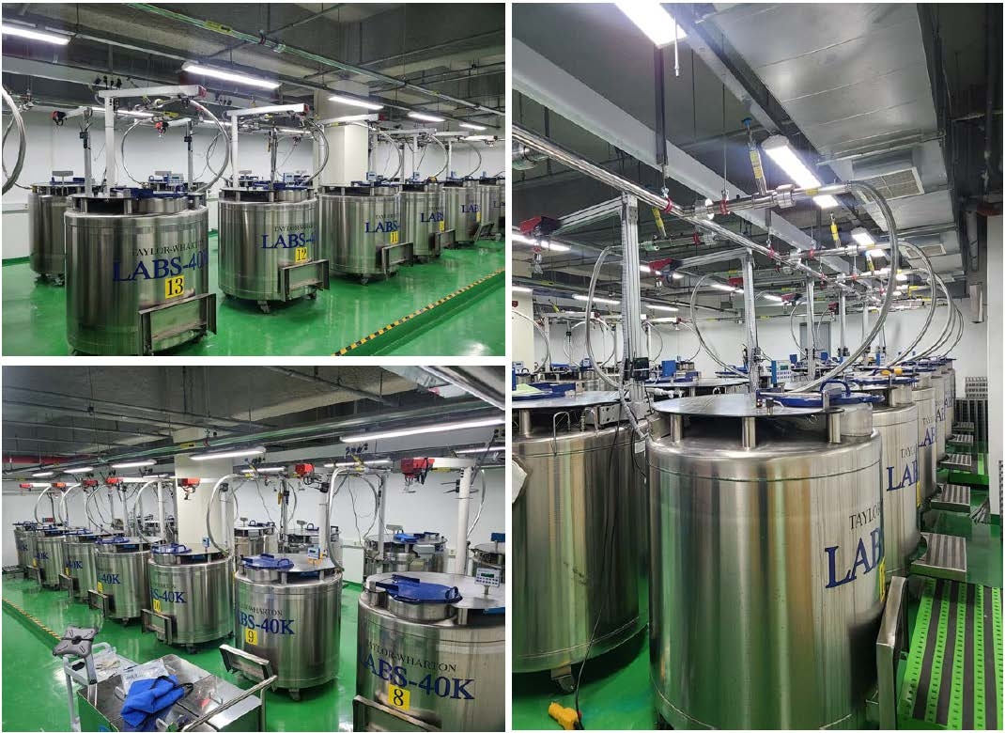
korea cryogenics

Slide 31
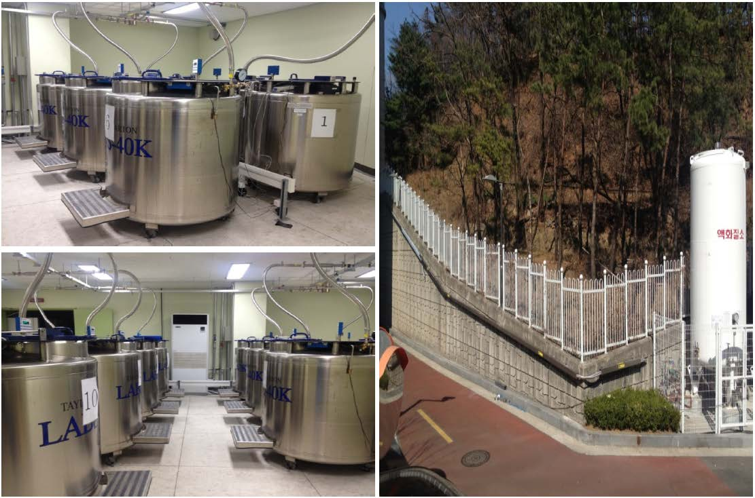
korea cryogenics

Slide 32
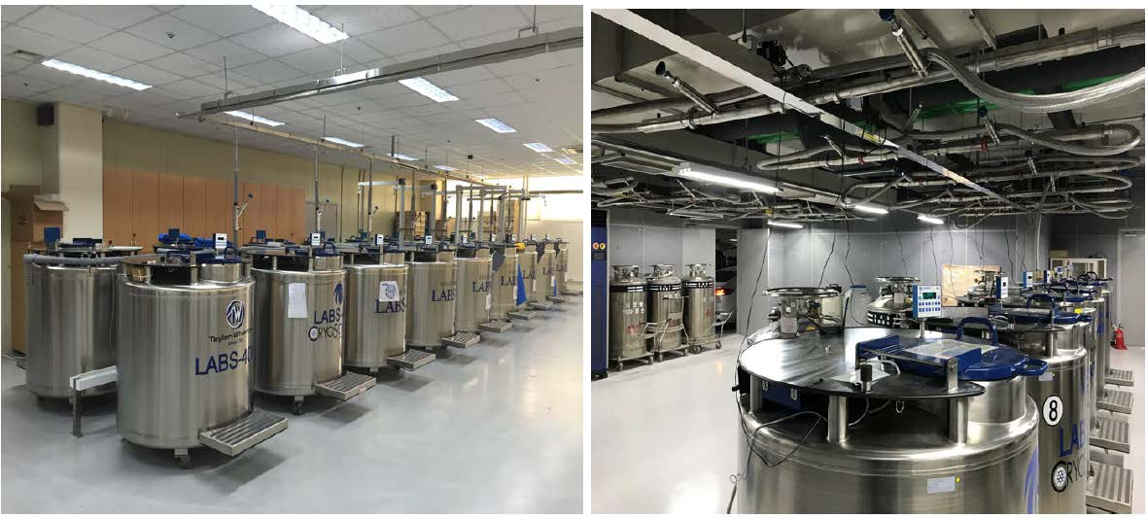
korea cryogenics

Slide 33
한국초저온용기㈜
korea cryogenics co.,
ltd.
감사합니다 Thank you.
More Information
koreacryo.com
+8231-737-8171 chrispark@koreacryo.com

